Slide 1
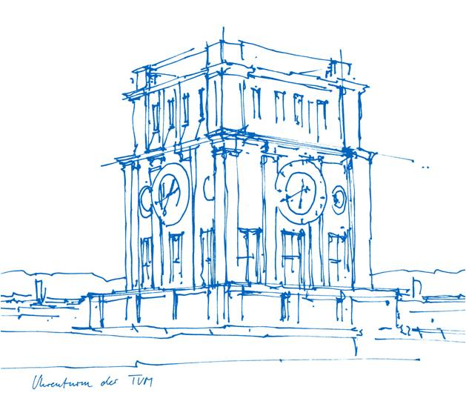
Trusted execution environment and software security
Peng Xu
peng@sec.in.tum.de
Lehrstuhl für IT-Security, Fakultät für Informatik,
Technische Universität München
23.04.2019

Slide 2
Agenda
Problems and Solutions
Problems
Solutions
Trusted Execution Environment
Architecture
Examples
Courses
Content
Tasks and exercises
Requirements
Grading

Slide 3
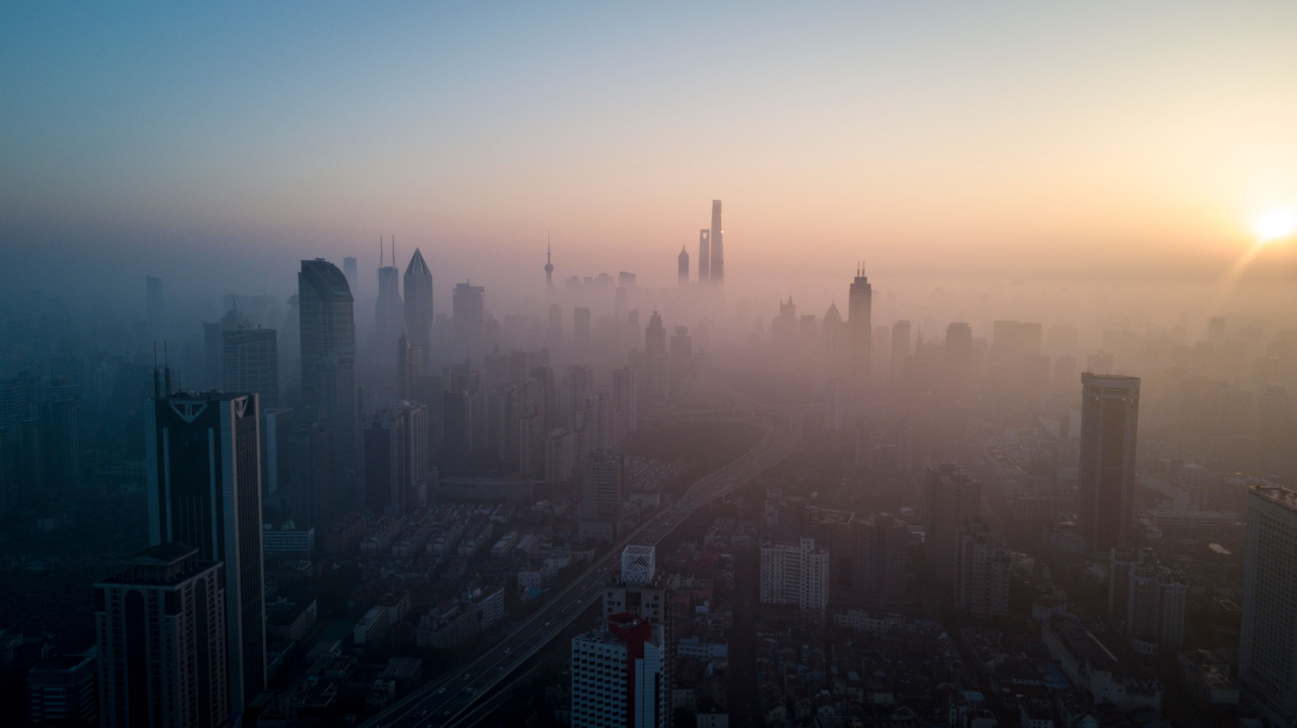
Problems？

Slide 4
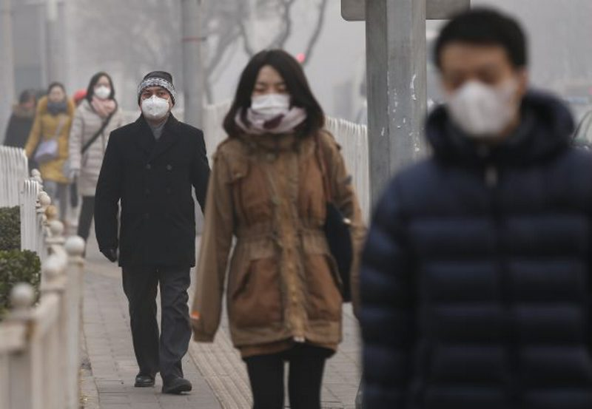
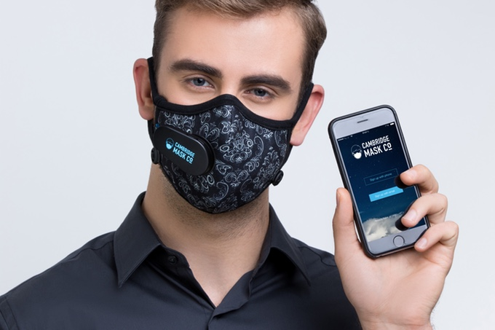
Problems？

Slide 5
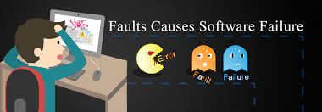
Problems？

Slide 6
Problems？

Slide 7
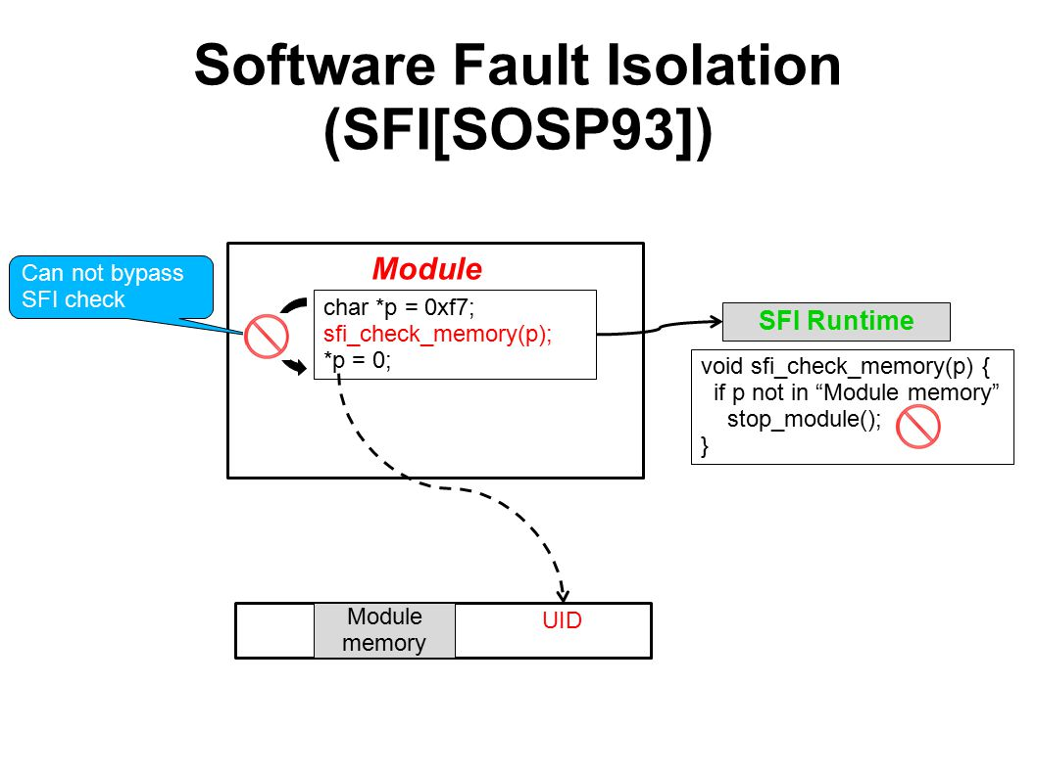
Solutions – Software fault isolation

Slide 8
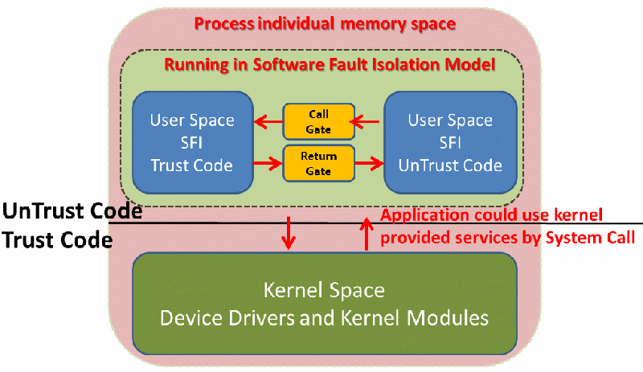
Solutions – Software fault isolation
https://drive.google.com/file/d/0B5pbq4t2T2_fM2h1dnd3TFRud0E/view

Slide 9
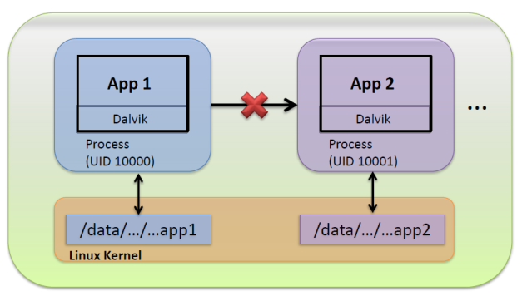
Solutions – Sandbox

Slide 10
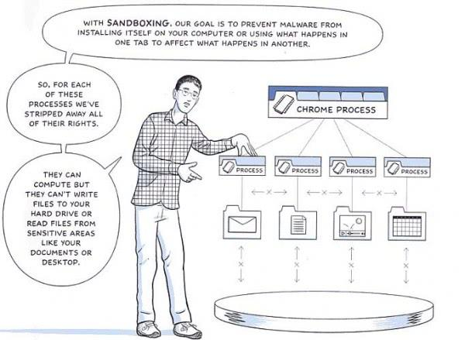
Solutions – Sandbox
https://www.ghacks.net/2012/08/09/chromes-flash-sandbox-improves-with-better-security-less-crashes/

Slide 11
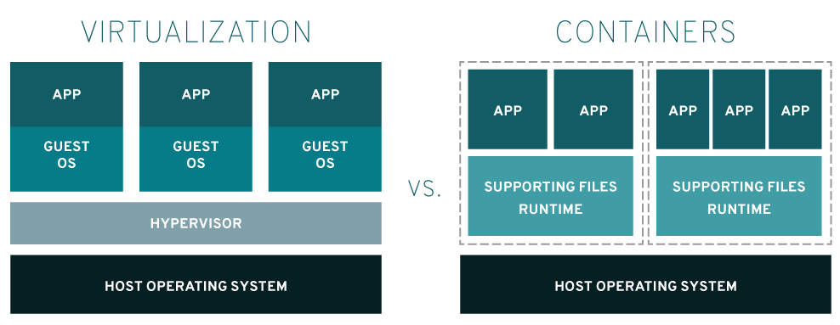
Solutions – Virtualization & Containers

Slide 12
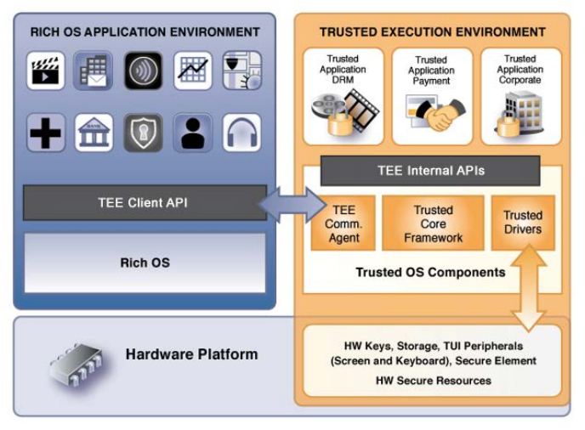
Solutions – Hardware isolation

Slide 13
Problems and Solutions
Problems
Solutions

Slide 14
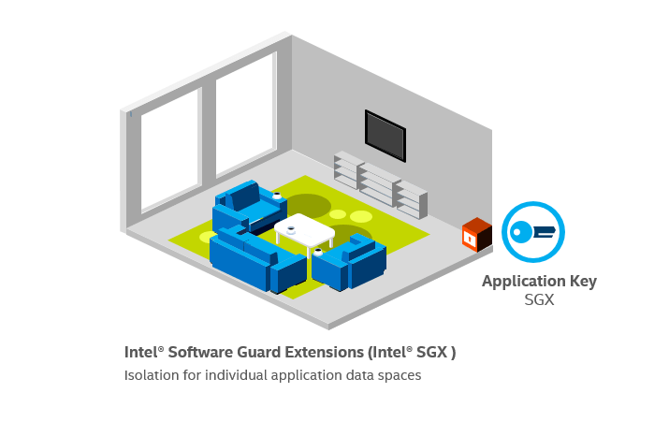
TEE Architecture – Intel SGX

Slide 15
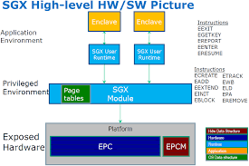
TEE Architecture – Intel SGX

Slide 16
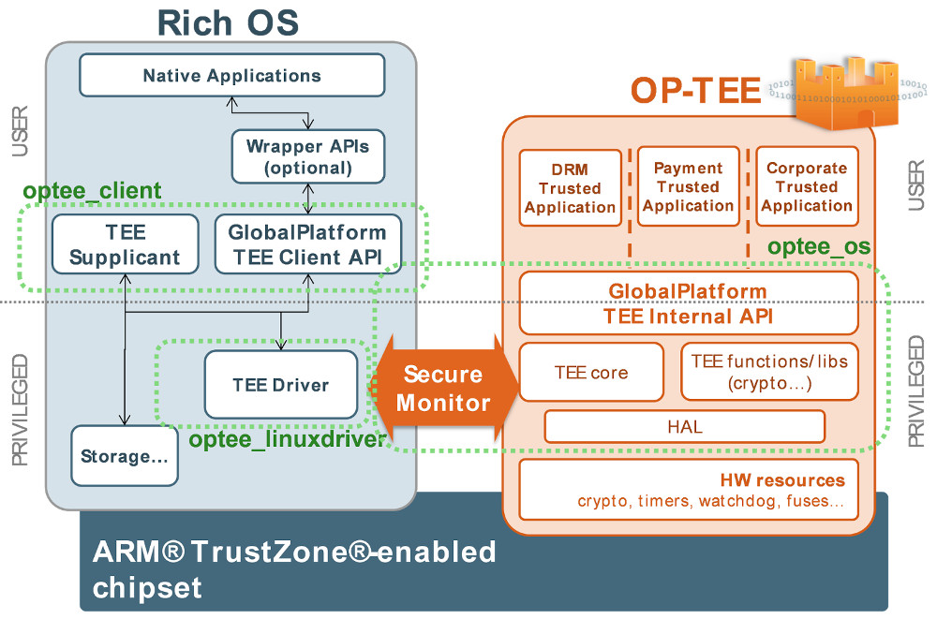
TEE Architecture – ARM TrustZone

Slide 17
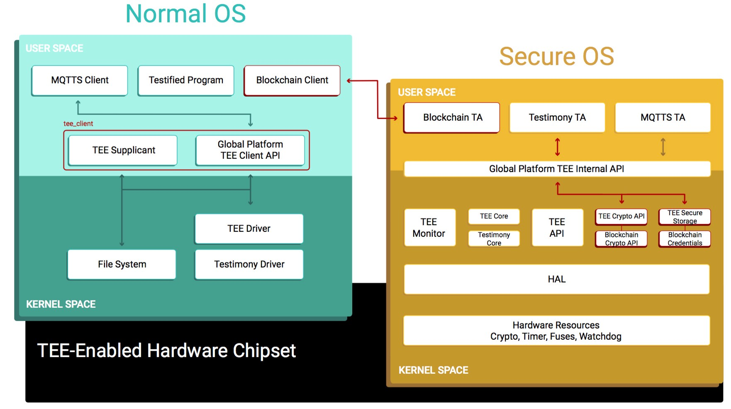
https://medium.com/weeves-world/ethereum-wallet-in-a-trusted-execution-environment-secure-enclave-b200b4df9f5f

Slide 18
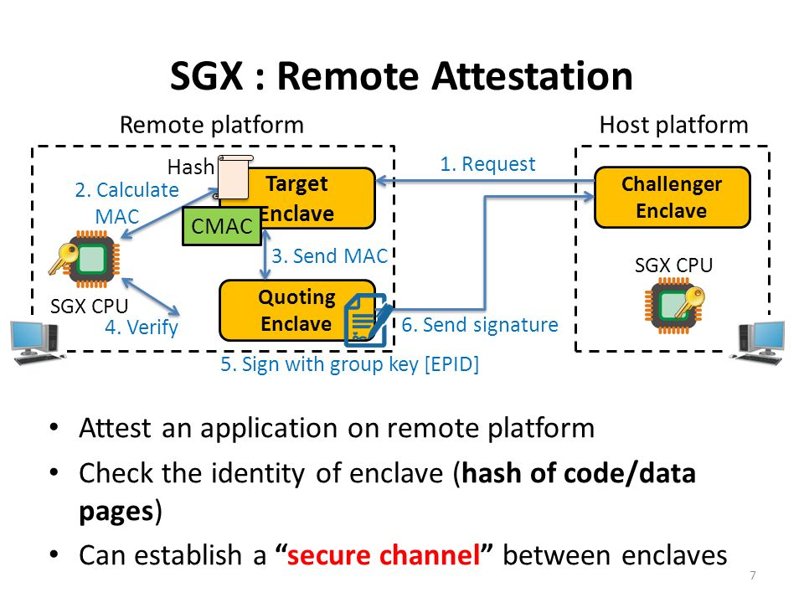
https://slideplayer.com/slide/8844767/

Slide 19
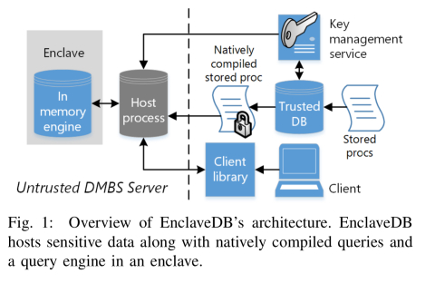
https://www.microsoft.com/en-us/research/uploads/prod/2018/02/enclavedb.pdf

Slide 20
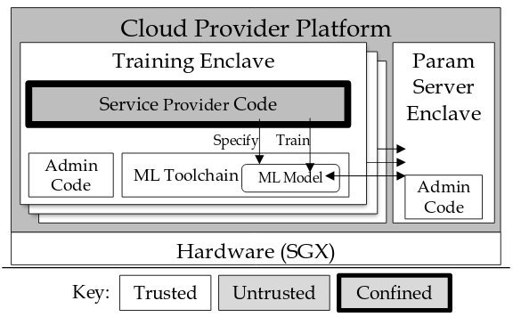
https://twitter.com/rzshokri/status/985792775189757952

Slide 21
Problems and Solutions
Problems
Solutions
Trusted Execution Environment
Architecture
Examples

Slide 22
Pre-knowledge
C/C++ programming language
Basic knowledge of the operating system
Program analysis: static analysis and dynamic analysis
Knowledge of compiler is better (LLVM/GCC)
Sever access
Ssh username@praksrv.sec.in.tum.de
Username and passwd, I will send them by email
www.in.sec.in.tum.de

Slide 23
Content and Tasks
Attestation(local/remote)
Sealed Data storage/Secure_storage
Encryption/decryption
Random
SGX performance analysis tool
Enclave_database
Enclave_ssl
Enclave_ledger
Automatic program slicing

Slide 24
Grading
Homework
Attendance
Discussion

